Slide 1
Positive attitudes toward illness in PNES
S. Marc Testa, Ph.D.
Neuropsychologist, VA Maryland Health Care System, Baltimore

Slide 2


Collaboration and Support
Epilepsy Foundation and the Gertrude A. Sergievsky Research Endowment
Collaborators
Jason Brandt, Ph.D.
Ronald P. Lesser, M.D.
Gregory L. Krauss, M.D.
Research Assistants
Sarini Ettigi, B.A.
Shaina Fieldstone, M.A.
Jung Geum Im, M.A.

Slide 3

Benefits of the sick role
Notes:
It is often thought that some patients with PNES have an unconscious drive to be in a “sick role.”
Perhaps because it relinquishes them from responsibility for not meeting stressful life demands?
Is there empirical support for this?

Slide 4

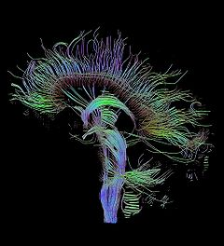
How can we measure implicit attitudes?
Notes:
However, people may not say what's on their minds because they are unwilling or unable to do so.
The unwilling-unable distinction is like the difference between purposely hiding something from others and unconsciously hiding something from yourself.
How can we measure such implicit attitudes?
What if we asked a patient with psychogenic seizures –
Is being sick benefitting you in some way?
Patients would be unable to answer that…..perhaps unwilling.

Slide 5
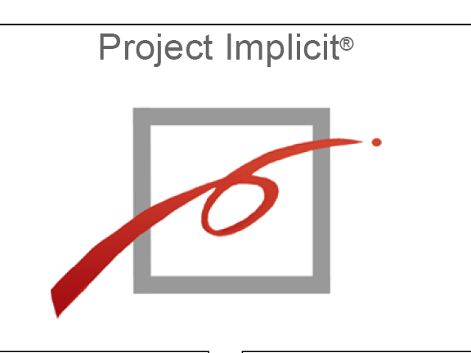
Notes:
Project implicit is a web site that allows you to assess your own attitudes toward race, gender, and politics.
We used the approach to ask : Do patients with PNES have positive attitudes toward illness?

Slide 6
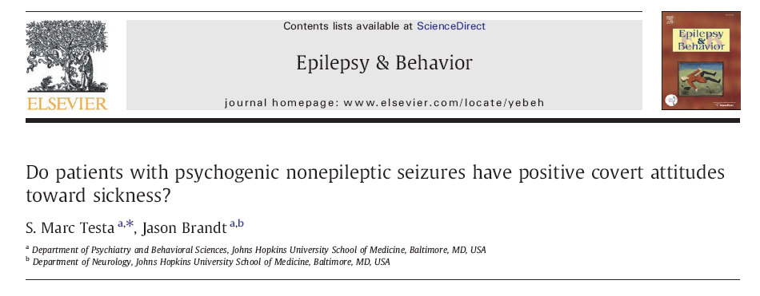
Notes:
We developed an Implicit Association Test designed to measure implicit attitudes toward illness that patients might be unwilling or unable to report.
Participants sort words that appear on a computer screen by pressing one of two keys.
The IAT introduces a “conflicting” condition and a “compatible”
“compatible” condition
Healthy/Pleasant words share a key – VIGOR and FlOWER are sorted by the same key
Sick/Unpleasant and CONVULSION AND MAGGOT are SORTED to another KEY
“conflicting” condition
This time
Sick/Pleasant CONVULSION ANd FLOWER are sorted by the same key
Healthy/Unpleasant VIGOR and MAGGOT are SORTED to another KEY
It is assumed that interference will occur in the conflicting condition and slow sorting times.
Thus, a positive attitude toward illness in one group might be inferred from FASTER reaction times on the “conflicting” condition

Slide 7
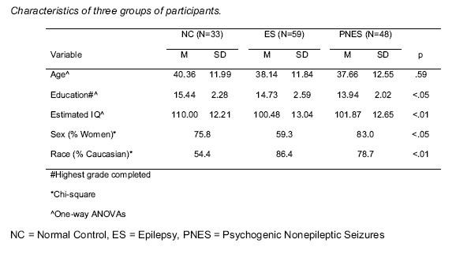
Notes:
The groups differed on several demographic characteristics (see Table 1).
Age did not differ between
NC group was more highly educated and had higher estimated IQs than the ES and PNES groups.
The proportion of women in the PNES and NC group were similar, but higher than in
the ES group.
The NC group contained fewer Caucasians than either the ES or PNES groups.
To determine whether group differences in education, estimated IQ, sex, and race, contributed to the reported findings, we repeated each analysis entering these variables as covariates.
These analyses revealed that education, estimated IQ, sex, and race are not influencing the group differences and correlations.

Slide 8
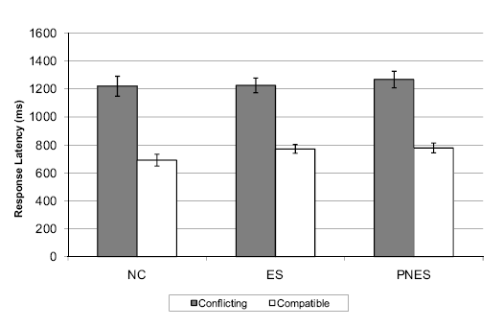
Notes:
OVERALL…….GROUPS DID NOT DIFFER
There is a slight trend for a smaller difference in PNES, but nothing remarkable.

Slide 9
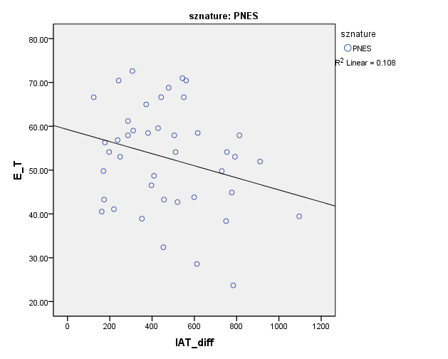
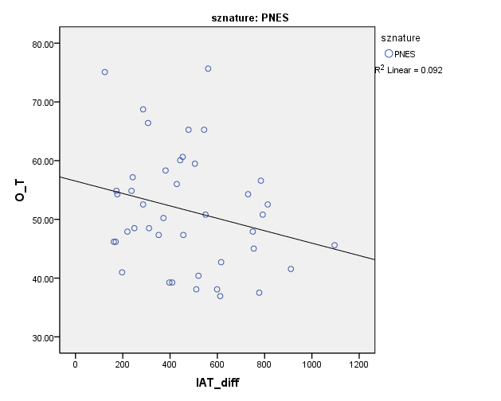
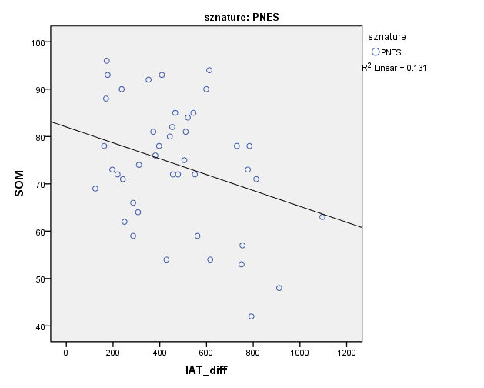
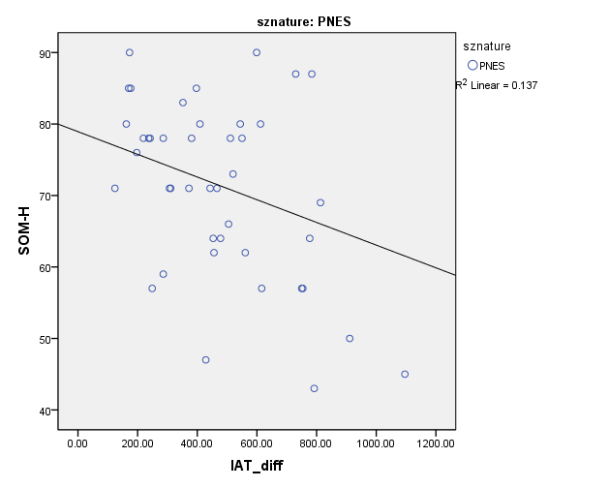
Notes:
We looked closer at the data to see if IAT difference scores
Were related to psychopathology or personality features…Very few significant correlations emerged.
However, some did…
A significant negative correlations in the PNES group between IAT and:
Somatic Complaints clinical scale (r= -0.36, p<.03)
Health Concerns subscale (r = -.37, p < .02).
Extraversion (r = -.33, p<.05)
Openness (r = -.30, p = .05).
High scores on these PAI and NEO
scales are associated with diminished IAT-difference scores.
To explore which additional variables might be related to the IAT
difference score….
a stepwise multiple regression model was calculated.
A final model was significant (p<.01) and showed extraversion (p<.02) and Health
Concerns (p < .004) accounted for 26% of the variance in the IAT difference score.

Slide 10
In sum….
This IAT methodology found little support for the notion that patients with PNES harbor positive attitudes toward illness.
Exploratory analyses showed a relationship between more neutral attitudes toward illness and:
Pronounced somatic focus
Higher extraversion
Limitations of our IAT methodology?

